Slide 1
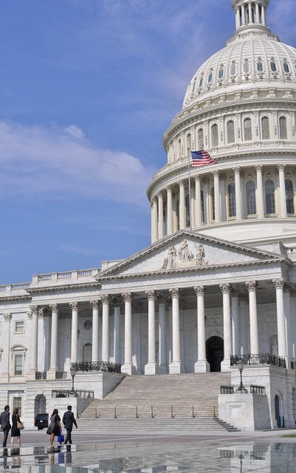
US tax policy
outlook
February 2022

Slide 2
Agenda
2021 Tax Developments
2022 Tax Policy Outlook
2022 Election Outlook

Slide 3
2021 tax policy recap
American Rescue Plan Act enacted
President’s FY 2022 budget submitted to Congress
OECD/G20 global tax agreement announced
Infrastructure Investment & Jobs Act enacted
Build Back Better Act passed by House
March 11
May 28
Oct. 8
Nov. 11
Nov. 19
American Rescue Plan Act of 2021
Repeal worldwide interest expense allocation rules Deny deduction of compensation > $1 million for 5 highest paid employees Modify exceptions for reporting of third-party network transactions Extend limit on excess business losses of noncorporate taxpayers to 2026 Provide relief for single- and multi-employer pension plans Extend and modify employee retention tax credit (sunset 12/31/21) Provide additional recovery rebates for individuals ($1400/person) Expand child credit, EITC, and dependent care assistance Increase and expand eligibility for ACA premium tax credit
Infrastructure Investment & Jobs Act of 2021
Reinstate Superfund chemical excise taxes (after 6/30/22) Information reporting for brokers and digital assets (after 12/31/23) Extend customs user fees until 9/30/31 Extend interest rate stabilization Terminate employee retention tax credit after 9/30/21 Extend highway-related taxes until 9/30/28 Provide disaster tax relief Expand tax-exempt bond financing Modify treatment of contributions to capital (after 12/31/20)

Slide 4
2022 outlook
TCJA business tax increases took effect
President Biden’s State of the Union address
Temporary government funding (CR) expires
Federal government’s fiscal year begins
Congressional midterm elections held
Jan. 1
March
March 11
Oct. 1
Nov. 8
Budget reconciliation (Build Back Better Act)
Trade (US Innovation & Competition Act)
Retirement security (SECURE Act 2.0)
Expired & expiring tax provisions (tax extenders)

Slide 5
House-passed Build Back Better Act of 2021 $1.7 trillion reconciliation bill primarily offset by tax increases
What’s in | What’s out
15% corporate minimum tax on large corporations (tyba 12/31/22) | Corporate tax rate increase (Biden: 28%; W&M bill: 26.5%)
1% excise tax on corporate stock repurchases (rosa 12/31/21) | Accelerated expansion 162(m) compensation deduction limitation
Section 163(n) business interest limitation (tyba 12/31/22) | Elimination of fossil fuel tax preferences
International tax reforms (GILTI, BEAT, FDII, etc.) | Top individual tax rate increase (from 37% to 39.6%)
4-year delay of R&D capitalization requirement from 2022 until 2026 | Billionaire tax (annual mark-to-market on unrealized capital gains)
Clean energy incentives (electricity, emissions, transportation, efficiency) | Capital gains and qualified dividend tax rate (Biden: 39.6%; W&M: 25%)
Millionaire surtax (5% on income > $10M; further 3% on income > $25M) | Section 199A phase-out for income > $400K
3.8% net investment income expansion for income > $400K | Carried interest (increase in holding period from 3 to 5 years)
SALT deduction cap relief (increase to $80,000 for 2021 thru 2030) | Estate and gift tax changes (exemption, grantor trusts, valuation)
Permanent excess business loss limitation for noncorporate taxpayers | College and university endowment excise tax relief
Retirement provisions (mega-IRAs, back-door Roth conversion) | Retirement provisions (disqualified investment proposals)
QSBS exclusion, portfolio interest exemption, wash/constructive sale rules | Wyden partnership tax reform proposals
Superfund excise tax on crude oil and petroleum products | Increase tax on certain tobacco products (but nicotine tax is in)
Increased IRS enforcement funding | Bank account information reporting

Slide 6
Build Back Better Act of 2021 – key business tax provisions
Provision | Effective Date | JCT Estimate
15% minimum tax on adjusted financial statement income of corporations with book income > $1 billion | tyba 12/31/22 | $319 billion
1% excise tax on publicly traded US corporation for value of any stock repurchased by corporation | rosa 12/31/21 | $124 billion
Modify deduction for foreign-derived intangible income (FDII) and global intangible low-taxed income (GILTI) | tyba 12/31/22 | $144 billion
Modify GILTI: 15% rate on per-country basis, FTC haircut reduced from 20% to 5%, QBAI reduced from 10% to 5% | tyba 12/31/22 | $57 billion
Modify base erosion anti-abuse tax (BEAT): 12.5% rate in 2023, 15% rate in 2024, and 18% rate in 2025 | tyba 12/31/21 | $67 billion
Limit interest deduction to proportionate share of total earnings of international financial reporting group | tyba 12/31/22 | $28 billion
Delay from 2022 to 2026 2017 tax reform law requiring capitalization of research expenditures | n/a | ($4 billion)
Reinstate Superfund excise taxes on crude oil and petroleum products | 7/1/22 | $13 billion

Slide 7
Build Back Better Act of 2021 – key individual tax provisions
Provision | Effective Date | JCT Estimate
5% surtax on modified AGI > $10 million and additional 3% surtax (total of 8%) on modified AGI > $25 million | tyba 12/31/21 | $228 billion
Expand 3.8% net investment income tax to include net pass-thru business income for high-income taxpayers | tyba 12/31/21 | $252 billion
Make permanent limit on excess business losses of non-corporate taxpayers with carryforward modification | tyba 12/31/20 | $160 billion
Increase SALT deduction cap from $10K to $80K through 2030; reinstate $10K cap for one year (2031) | tyba 12/31/20 | ($14.8 billion)
Deny 75% and 100% QSBS exclusion rates and AMT preference elimination for AGI > $400K | saeoa 9/31/21 | $5.7 billion
Prohibit IRA contributions and require mandatory distributions for accounts > $10M and income > $400K | tyba 12/31/28 | $7.3 billion
Limit Roth IRA contributions for any qualified plans or IRA where any portion contains after-tax contributions | tyba 12/31/21 | $2.7 billion

Slide 8
Build Back Better Act of 2021 – clean energy tax provisions
Structures new and existing renewable energy and energy efficiency incentives as 2-tiered incentives
“Base rate” and “bonus rate” equal to 5x base rate for projects which meet prevailing wage and apprenticeship requirements
Extends and expands existing tax credits for renewable electricity (§48 ITC and §45 PTC), carbon sequestration (§45Q), alternative vehicles and fuels, alternative fuel vehicle refueling property (§30C), advanced energy projects (§48C), and energy efficiency
Provides new tax credits for:
Clean electricity production and investment (§48F and §45BB)
Electric transmission property (§48D)
Zero-emission nuclear power production (§45W)
Clean hydrogen production (§45X)
Clean fuel production (§45CC)
Advanced manufacturing production and investment (§48E and §45AA)
Sustainable aviation fuel
Provides 5-year transition to emissions-based, “technology-neutral” tax incentives for clean electricity and fuel production
Provides higher credit rates for §48 ITC, §45 PTC, §45BB, §48F projects that meet certain domestic content requirements
Provides direct-pay option under §48, §45, §45Q, §30C, §48C, §48D, §45W, §45X, §48E, §45AA, §45BB, §48F, §45CC
Expands definition of qualified income for publicly traded partnerships (PTPs) to include green and renewable energy

Slide 9
Build Back Better Act of 2021 – key Senate modifications
Corporate alternative minimum tax
Adjusted to disregard book-tax-differences related to defined benefit pension plans
For tax-exempt entities, adjusted to take into account only UBTI or unrelated debt-financed income
AMT foreign tax credit modified for foreign corporations
New section 163(n) business interest limitation
Modified to include election to determine limitation based on adjusted basis of assets rather than EBITDA
Base erosion and anti-abuse tax (BEAT)
Include changes to treatment of COGS in determining 3% base erosion percentage for 2022 and 2023
Section 245A dividend received deduction
Provide 65% DRD for dividends received by US shareholder directly from 10/50 corporation
Certain dividends received by CFC from specified 10% owned foreign corporation qualify for DRD
Section 7874 anti-corporate inversion rules
Reduces continuity of ownership thresholds from 80% to 65% and from 60% to 50%
Modifications to various clean energy tax incentive provisions

Slide 10
OECD global tax agreement – what’s next
In October 2021, G20 leaders endorsed the OECD/G20 Inclusive Framework on Base Erosion and Profit Shifting (Inclusive Framework) political agreement on a two-pillar plan to address the tax challenges arising from the digitalization of the economy.
G20 Finance Ministers & Leaders political endorsement
Pillar One
consultations
on rolling basis
as issues
rolled out
MLC for Pillar One: development and open for signature with signing ceremony in mid-2022
Implementation Framework for GloBE rules to be developed by the end of 2022 … or early 2023
Pillar One MLC ratification and entry into force and effect
Implementation of some IF countries with slower processes
EU Draft
Directive
for Pillar Two
Oct 2021
Dec
2021
First half 2022
Mid-late 2022
2023
2024
Pillar Two
GloBE
model rules
Pillar Two
Consultation
once Commentary released
Pillar Two STTR model provision and MLI language to be developed
Amount B model rules to be finalized by the end of 2022
Pillars One & Two expected implementation in the EU
UTPR to come
into effect
Interim period where signatory countries will not introduce any newly enacted DSTs

Slide 11
Looking ahead to 2022 midterm elections Historically, the president’s party loses seats in midterm elections
President’s party gain/loss of seats in House
Democrats hold narrow Congressional majorities going into 2022 (House: 222 D, 212 R, and 1 vacancy)
The last 4 presidents have lost Senate and House majorities; 7 of those 8 chambers were lost in midterm elections
Presidents with a sub-50% approval rating lose an average of 36 seats in the midterms
Biden’s approval rating is lower than those of many recent presidents at this point in their presidencies.
House: 30 Democrats and 13 Republicans are not seeking re-election in 2022
Senate: 5 Republicans and 1 Democrat are not seeking re-election in 2022
MIDTERM ELECTIONS, 1946-2018
President’s party gain/loss of seats in Senate
MIDTERM ELECTIONS, 1946-2018

Slide 12
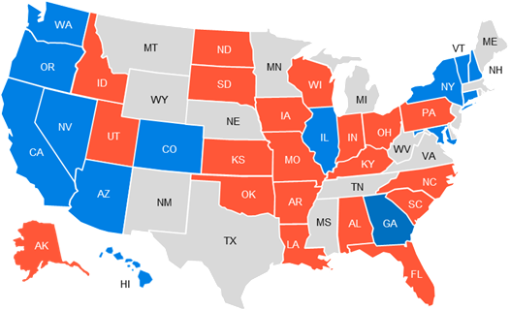
Looking ahead to 2022 Senate races Republicans defending more seats (20) than Democrats (14)
Toss Up
AZ – Kelly
GA – Warnock
NC – Open (Burr)
NV – Cortez Masto
PA – Open (Toomey)
WI – Johnson
Lean Democrat
NH – Hassan
Lean Republican
FL – Rubio
OH – Open (Portman)

Slide 13
What questions do you have?
© 2022 PwC. All rights reserved. PwC refers to the US member firm or one of its subsidiaries or affiliates, and may sometimes refer to the PwC network. Each member firm is a separate legal entity. Please see www.pwc.com/structure for further details.

